Slide 1

On the Sounds of Cities
Please wear headphones for better audio
Blanche Shao
11.S942 Final Presentation
Wanderings in Psychogeography

Slide 2
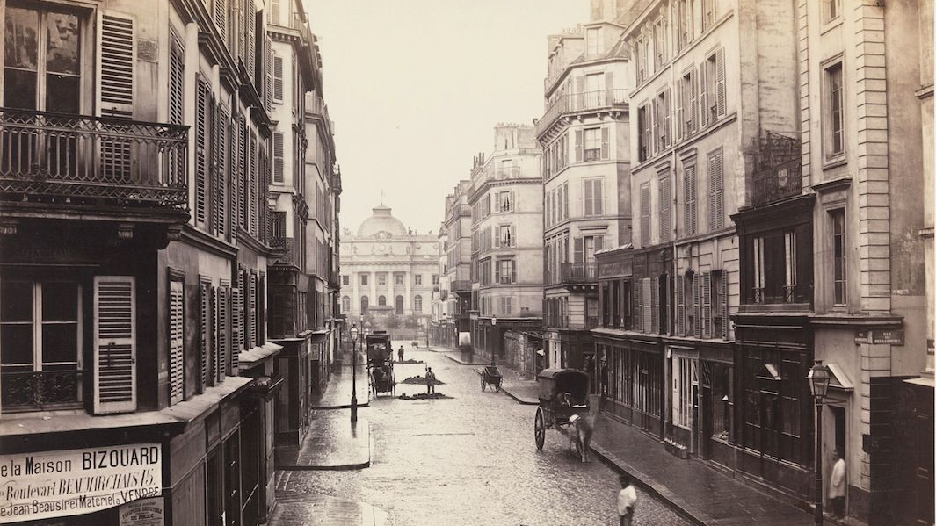
But First…Awakening Other Senses of Cities
Scents…
…in the cities a stench barely conceivable to us modern men and women. The streets stank of manure, the courtyards of urine, the stairwells stank of moldering wood and rat droppings, the kitchens of spoiled cabbage and mutton fat…People stank of sweat and unwashed clothes; from their mouths came the stench of rotting teeth, from their bellies that of onions, and from their bodies, if they were no longer very young, came the stench of rancid cheese and sour milk and tumorous disease. The rivers stank, the marketplaces stank, the churches stank, it stank beneath the bridges and in the palaces. The peasant stank as did the priest, the apprentice as did his master’s wife, the whole of the aristocracy stank, even the king himself stank, stank like a rank lion, and the queen like an old goat, summer and winter. For in the eighteenth century there was nothing to hinder bacteria busy at decomposition, and so there was no human activity, either constructive or destructive, no manifestation of germinating or decaying life that was not accompanied by stench. And of course the stench was foulest in Paris, for Paris was the largest city of France.
Patrick Suskind , Perfume: The Story of a Murderer
Background photo: public domain
Quotation: © Alfred A. Knopf. All rights reserved. This content is excluded from our Creative
Commons license. For more information, see https://ocw.mit.edu/help/faq-fair-use/.

Slide 3
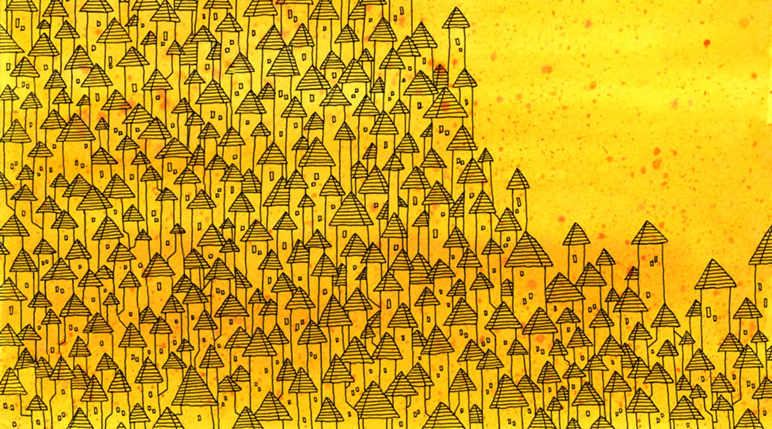
But First…Awakening Other Senses of Cities
Touch (temperature, moisture, etc.)…
Sickness…
Imagination…
..the people who move through the streets are all strangers. At each encounter, they imagine a thousand things about one another; meetings which could take place between them, conversations, surprises, caresses, bites. But no one greets anyone; eyes lock for a second, then dart away, seeking other eyes, never stopping...something runs among them, an exchange of glances like lines that connect one figure with another and draw arrows, stars, triangles, until all combinations are used up in a moment, and other characters come on to the scene...
With cities, it is as with dreams: everything imaginable can be dreamed, but even the most unexpected dream is a rebus that conceals a desire or, its reverse, a fear. Cities, like dreams, are made of desires and fears, even if the thread of their discourse is secret, their rules are absurd, their perspectives deceitful, and everything conceals something else.
Italo Calvino, Invisible Cities
Background image: © Matt Kish. All rights reserved. This content is excluded from our Creative Commons license.
For more information, see https://ocw.mit.edu/help/faq-fair-use/.
Quotation: © Houghton Mifflin Harcourt. All rights reserved. This content is excluded from our Creative
Commons license. For more information, see https://ocw.mit.edu/help/faq-fair-use/.

Slide 4

But First…Awakening Other Senses of Cities
Sounds…
A soundwalk is any excursion whose main purpose is listening to the environment. It is exposing our ears to every sound around us no matter where we are. We may be at home, we may be walking across a downtown street, through a park, along the beach; we may be sitting in a doctor's office, in a hotel lobby, in a bank; we may be shopping in a supermarket, a department store, or a Chinese grocery store; we may be standing at the airport, the train station, the bus-stop. Wherever we go we will give our ears priority. They have been neglected by us for a long time and, as a result, we have done little to develop an acoustic environment of good quality.
Hildegard Westerkamp, “Soundwalking”
Background image: © source unknown. All rights reserved. This content is excluded from our Creative Commons license.
For more information, see https://ocw.mit.edu/help/faq-fair-use/.
Quotation: © Hildegard Westerkamp. All rights reserved. This content is excluded from our Creative Commons license.
For more information, see https://ocw.mit.edu/help/faq-fair-use/.

Slide 5
A Soundwalk Exercise
Try to move
Without making any sound.
Is it possible?
Which is
the quietest sound of your body?
What do you hear? (Make a list)
What else do you hear?
Other people
Nature sounds
Mechanical sounds
How many
What are the sources of the different sounds?
What else do you hear?
Lead your ears away from these sounds and listen
beyond-----into the distance.
What is the quietest sound?
What else do you hear?
What else?
What else?
Background image: © source unknown. All rights reserved. This content is excluded from our Creative
Commons license. For more information, see https://ocw.mit.edu/help/faq-fair-use/.
Notes:
Start by listening to the sounds of your body while moving. They are closest to you and establish the first dialogue between you and the environment.
Now, Lead your ears away from your own sounds and listen to the sounds nearby.
So far you have isolated sounds from each other in your listening and gotten to know them as individual entities. But each one of them is part of a bigger environmental composition.

Slide 6
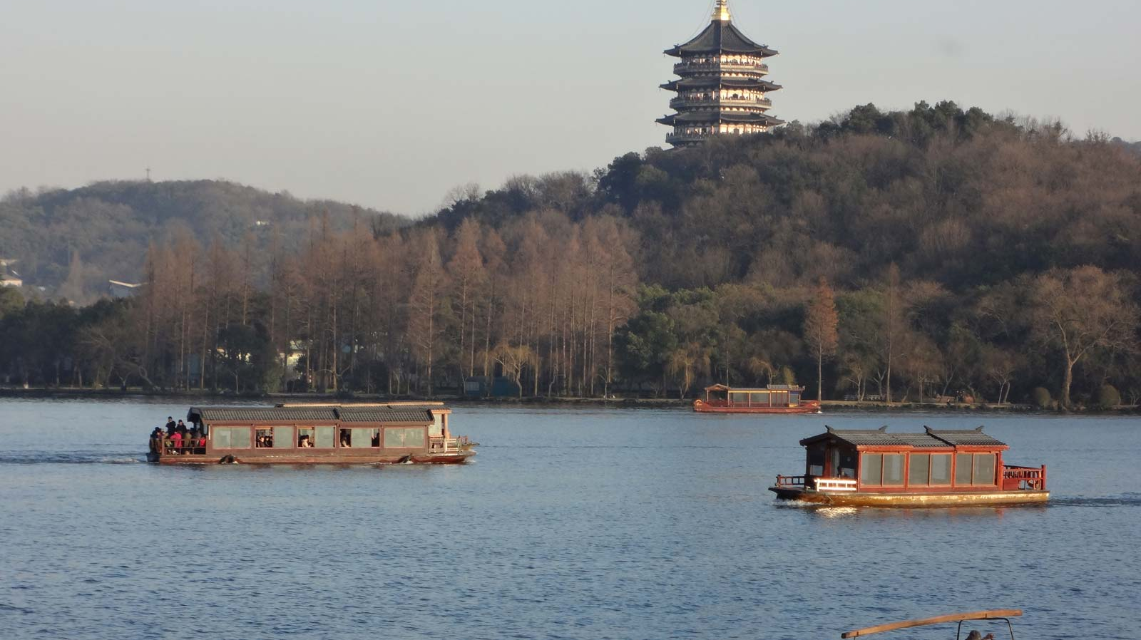
Two Soundwalks
6:23pm, November 28, Rainy
Standing at the entrance of a coffee shop, I found my soundwalk exercise disrupted by the rain. I mostly heard the rain hitting the ground and shop windows. It was suddenly surprising to me that something so shapeless could make such loud noises .There was also car honking and braking rapidly, leaving a loud screeching and trace on the road. Closing my eyes and trying to listening more undistracted by my vision cues, I heard footsteps of people running to hide from the pouring rain, opening and closing of umbrellas, people hailing for a cab and then fighting over it across the street.
4:34pm, December 1, Sunny
Listening to the city in different weathers are entirely two distinct experiences. This time, I could walk outside instead of cramming at the entrance of a little coffee shop. Besides the occasional car honking, the sounds on the streets had mostly become cars speeding by and people chatting on the phone. I started to think that city sounds are all the same—there was no way to tell which city I was at just by listening to the sounds.

Slide 7

Sounds as Place Markers
1
2
3
4
5

Slide 8
Sounds as City Identities (?)
1
2
3
4
5

Slide 9
Sounds as Temporalities
Seasonality
Modernity

Slide 10
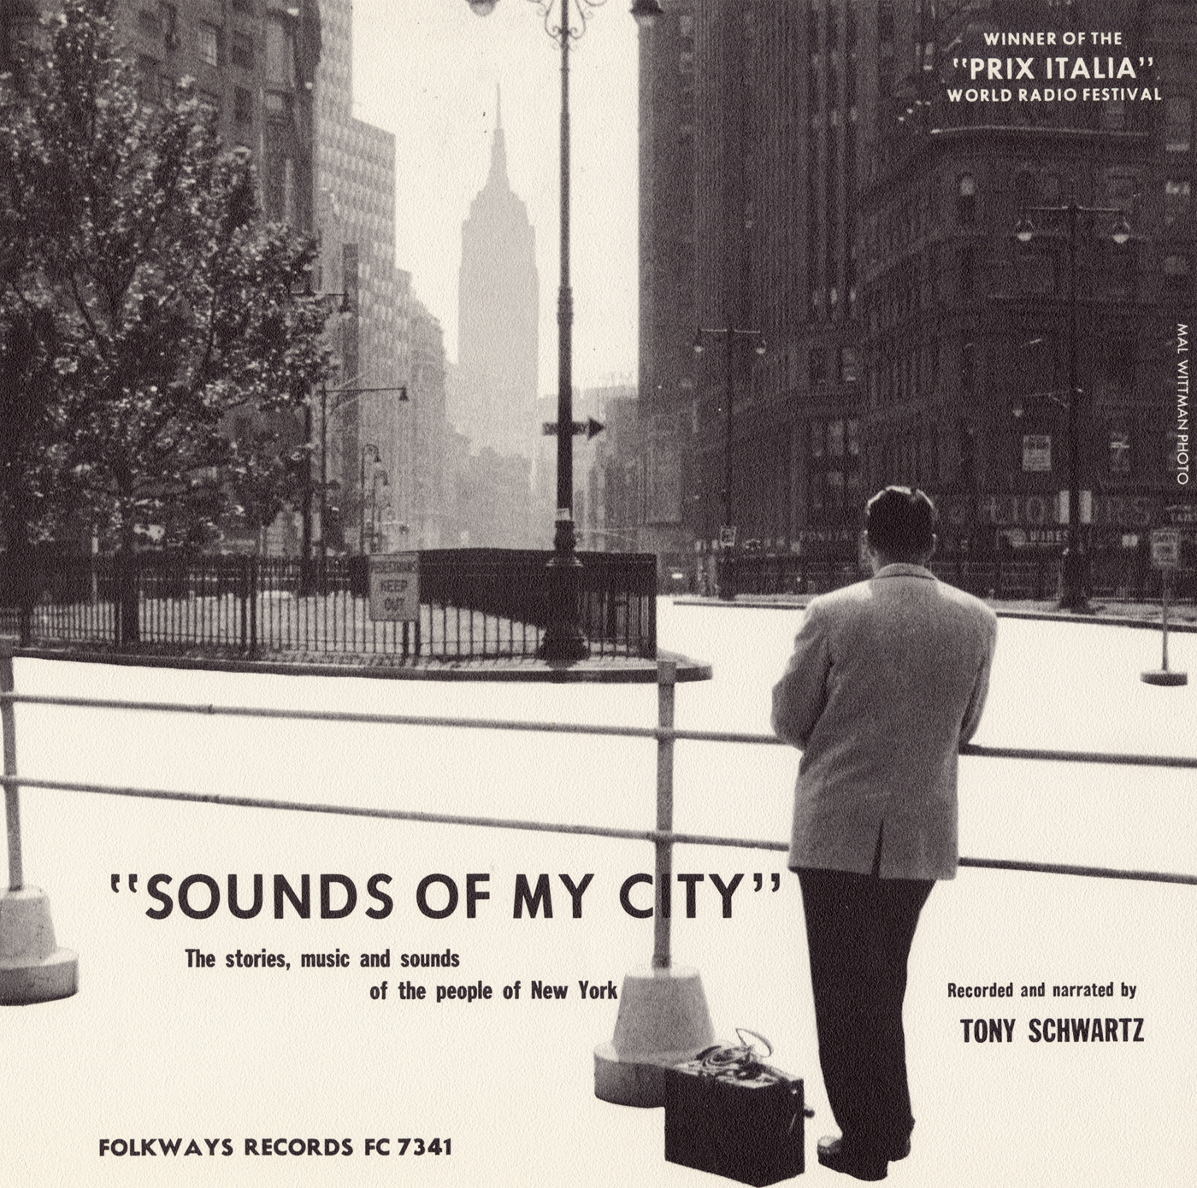
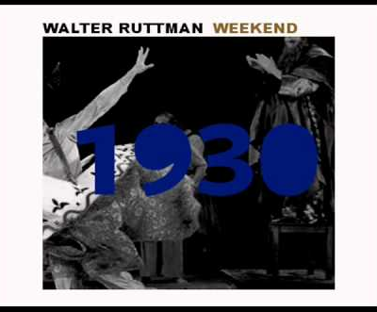
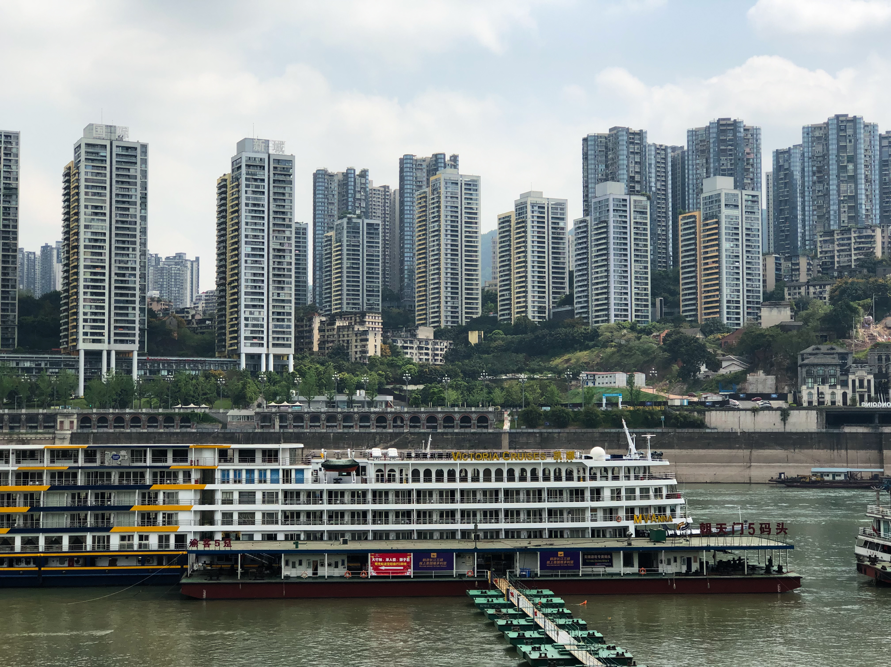
Sounds as Arts, History, City Memory…
Sounds of My City, Tony Schwartz
Weekend, Walter Ruttmann
Sound archive of Chongqing
Left: © Smithsonian Institution. All rights reserved. This content is excluded from our Creative
Commons license. For more information, see https://ocw.mit.edu/help/faq-fair-use/.
Center: © source unknown. All rights reserved. This content is excluded from our Creative
Commons license. For more information, see https://ocw.mit.edu/help/faq-fair-use/.
Notes:
Sounds of My City: The Stories, Music and Sounds of the People of New York
Tony Schwartz
Over the course of nine years, Tony Schwartz collected the sounds of New York, seeking to record "the audible expression of life." Originally produced as a radio program for WNYC, the finished product is a lucid representation of the city, capturing street sounds, immigrant voices, lively music, raindrops, bird songs, and even the pragmatic advice of the city’s cabbies.
Part anthropological study, part hometown travelogue, the recordings contextualize the city's shifting rhythms and urban folklore as a meaningful collection of sounds, each one with a specific purpose and significance to the eight million inhabitants (plus an unknown number of cats and dogs).

Slide 11
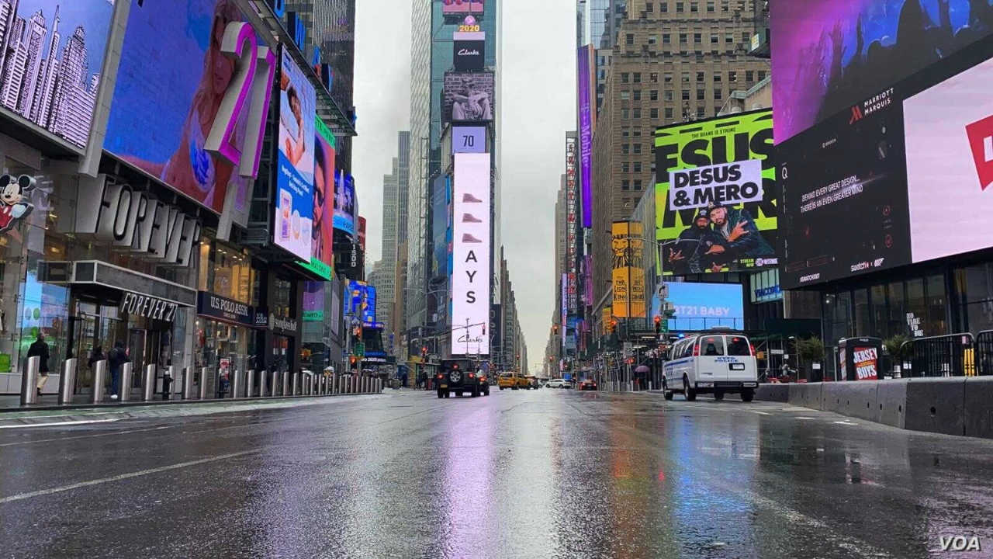
My Project: The Acoustic Experience of Living in Cities During COVID-19
See slide 14 for video photo credits.
Notes:
Alternative means to document this pandemic

Slide 12
My Project: The Sound of Cities During COVID-19
Temporality: signaled through the repetition of sirens with different levels of loudness
Uncanny juxtaposition: mismatching pictures with sounds
Global perspective: incorporating scenes from four different regions--India, U.S., Italy, and China
What could be included:
  having different soundtracks for different regions to resolve the language issue
  different sound tracks to represent different groups’ acoustic experience

Slide 13
Questions & Remarks
Go on a soundwalk today!

Slide 14
Still images from project video:
Times Square: © Celia Mendoza / VOA.
Empty street with police car: photo courtesy of Nicolas Mirguet on Flickr. License CC BY-NC.
Parade: © Andres Kudacki / AP.
Young people at table: © source unknown.
People in park: © source unknown.
Empty street with kiosk: © Mike Dotta.
Subway car: © source unknown.
Masked crowd: © Kevin Frayer / Getty Images.
All images listed above are all rights reserved to their respective copyright holders. This content is excluded from our Creative Commons license. For more information, see https://ocw.mit.edu/help/faq-fair-use/.

Slide 15
MIT OpenCourseWare
https://ocw.mit.edu
11.S942 Wanderings in Psychogeography: Exploring Landscapes of History, Biography, Memory, Culture, Nature, Poetry, Surreality, Fantasy, and Madness
Fall 2020
For information about citing these materials or our Terms of Use, visit: https://ocw.mit.edu/terms.

